Slide 1

“Smart Glove for Special People Communication And Health Monitoring”
BHARATI VIDYAPEETH COLLEGE OF ENGINEERING FOR WOMENS,PUNE-43
Presented by: Under the Guidance of,
1. Madhvi Sonone(41203) Prof.S.V.Shelke
2. Pranali Yeole (41218)
3. Vanshika Sable (41226)

Slide 2
INTRODUCTION:
In our daily lives, we meet numerous specially abled people, a number of them in part, and several are completely disabled. People with partial disabilities like deaf, dumb and paralysis manage life with many difficulties. Here, conversation per- forms a substantial role as communication can make someone feel much better and can also help them be in place of an independent person. Flex Sensors play a major role in this particular undertaking. The flex sensors are actually outfitted on the glove along all fingers including the thumb. The flex receptors supply output in the form of distinct voltage variants which varies with various levels of bend angles. This particular output from the flex sensor is actually provided to a digital converter which transforms analog signals into discrete digital values through the routes of micro controllers. It alerts and performs the conversion of analog signal to a digital signal. Through this phase, the Gesture is actually diagnosed, and the appropriate output gets displayed on an LCD screen.
Consistent observing of the human's body parameters for example, temperature, heartbeat rate, voltage and so forth is a troublesome task. Likewise in intensive care units it is important to screen constantly the patient's health parameters and keep their record. There is plausibility of human mistakes .

Slide 3
LITERATURE SURVEY:
SR.NO | Name Of Author | Name of paper | Year | Comments
1. | Ms. Pallavi Verma, Mrs. Shimi S. L., D r. S. Chatterji, Mrs. Shimi S. L.” | Design of Smart Gloves | 2014 | Being deaf and dumb is considered to be a perceptual disability. To eradicate this barrier of communication in the gadget makes use of flex sensors, a micro controller and a PSU. Thesoftware component of this prototype uses embedded C written in Keil Micro vision.
2. | Harmeet Kaur, Amit Saxena, Abhishek Tandon, Ke- shavMehrotra, Khushboo Kashyap. | A Review Paper On Evo- lution Of Smart Glove. | 2017 | an immediate sign language recognition system was developed using the machine learning algorithm of Random Forest Classifier, as well as in order to convert the sign alphabets and words that are common into sound and text. A glove circuit has been created with flex sensors, a 3 axis accelerometer, along with a gyroscope to record the gestures or perhapssign data. The finger bend information is received from flex sensors on every finger as the accelerometer, as well as a gyroscope, offers the trajectories of the hand movement.

Slide 4
LITERATURE SURVEY:
SR.NO | Name Of Author | Name of paper | Year | Comments
3. | Rini Akmeliawati, Melanie Po-Leen Ooi and Ye Chow Kuang | “Real Time Sign Language Translation Using Colour Segmentation and Neural Network” | 2014 | Being deaf and dumb is considered to be a perceptual disability. To eradicate this barrier of communication in the gadget makes use of flex sensors, a micro controller and a PSU. Thesoftware component of this prototype uses embedded C written in Keil Micro vision.
4. | K. V. Fale, Pratik Chaudhari, Akshay Phalke, Pradeep Jadhav. | “Smart Glove: Gesture Vocalizer for Deaf and Dumb People’’ | - | This device offers an effective means of communication for both ordinary and deaf-dumb folks. All of these voices are customizable, and every end-user could have their own set of messages which enable them to communicate.

Slide 5
OBJECTIVES:
To design, implement and test a device for remotely monitoring hand and fingers movements.
Developing monitoring systems is to reduce health care costs by reducing physician office visits, hospitalizations, and diagnostic testing procedure. The GSM technology helps the server to update the patient data on website.

Slide 6
BLOCK DIAGRAM:
LCD 16X2 Display
Voice module
Power Supply
AVR Microcontroller
(ATmega328)
Body temp Sensor
GSM
Flex Sensor
Buzzer
Pulse Sensor
Relay Driver
Fan
Light

Slide 7
SOFTWARE TOOLS:
Avr Studio (Programming)
Express PCB (Circuit &layout design)

Slide 8
HARDWARE & EQUIPMENT:
Microcontroller (AT mega 328)
GSM model
Pulse Sensor
Buzzer
Relay
Regulator
Lcd 16*2

Slide 9
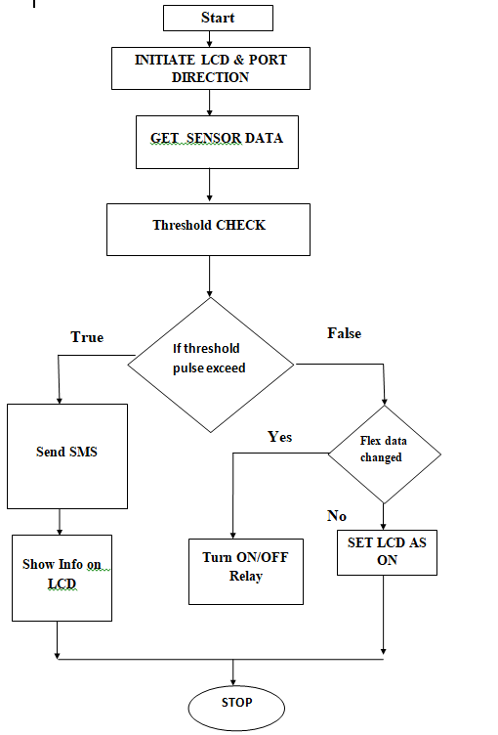
FLOWCHART:

Slide 10
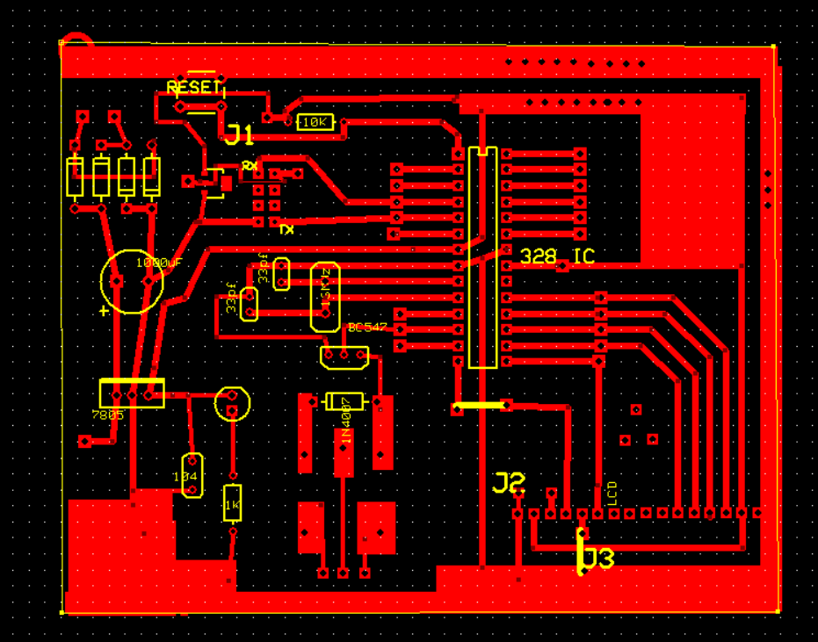
PCB Design

Slide 11
ADVANTAGES:
Remote patient monitoring (RPM) for clinicians — Ease of access to patient data, the ability to deliver higher-quality care to more patients with a lower risk of burnout — and for healthcare providers — lower costs and higher efficiency.
By helping patients mimic normal hand movement, NeoMano delivers obvious physical and psychological benefits, and increases confidence.
Cost effective system.

Slide 12
Applications:
Hospitals to provide patient information remotely.
Home care system.
Robotics for control by gesture.

Slide 13
FUTURE SCOPE:
Research is going into the IoT domain, there will be more added features with IoT .alternative of Flex sensor can also be found which gives accurate observation and which is not very fragile.
One of the Limitations is that only 31 predefined combinations can be loaded and executed in future with more accuracy we can increase this no of predefined gestures and make it very widespread. Other enhancement can be found to make this device a little compact.
Home automation can be made wireless through bluetooth or Wifi in future making the project compact and portable to carry around for a disabled person.

Slide 14
CONCLUSION:
The Smart Hand Gloves will provide a far more effective, dependable, and light-weight assembly to the end user than the already existing systems. This can play a huge task in creating meaning in the daily lives of Disabled People. During this particular task, we faced a variety of challenges like the price, weight, and portability of the unit. The Smart Hand Glove not only enables the abolishment of the communication barrier between the specially abled people and other individuals but also makes them independent by providing home automation functionalities. By using different angled bends, users can easily manage all electrical appliances.
Also this project provide is to diminish the hospitalization & assistance cost. Health checking application is essentially proposed to give alerts to medical health checking staff for the patients when required.

Slide 15
REFERENCES:
1. K. V. Fale, Pratik Chaudhari, Akshay Phalke, Pradeep Jadhav. ”Smart Glove: Gesture
Vocalizer for Deaf and Dumb People.” International Journal of Innovative Research in Computer
and Communication Engineering, Vol. 4, Issue 4, April 2016.
2. Ms. Pallavi Verma, Mrs. Shimi S. L., D r. S. Chatterji, Mrs. Shimi S. L.” Design of Smart
Gloves.” International Journal of Engineering Research Technology (IJERT), ISSN: 2278-
0181.Vol. 3 Issue 11, November-2014
3. Harmeet Kaur, Amit Saxena, Abhishek Tandon, Ke- shavMehrotra, Khushboo Kashyap. ”A
Review Paper On Evo- lution Of Smart Glove.” International Journal of Scientific Research
andManagement Studies (IJSRMS), ISSN: 2349- 3771, Volume 3, Issue 3, pg: 124-128.
4. Rini Akmeliawati, Melanie Po-Leen Ooi and Ye Chow Kuang, “Real Time Sign Language
Translation Using Colour Segmentation and Neural Network”, IEEE on Instrumentation and
Measurement Technology Conference Proceeding, War- saw, Poland 2012.
5. A Zigbee based home automation system Khushwinder Gill, ShuangHua Yang, Fang Yao, and
Xin Lu. IEEE Trans- actions on Consumer Electronics, Vol. 55, No. 2, MAY 2009.
6. VishwatejaMudiam Reddy, NareshVinay, Tappan Pokharna and Shashank Shiva Kumar Jha,
Internet of Things Enabled Smart Switch, Thirteenth International Conference on Wireless and
Optical Communications Networks (WOCN), Hyderabad, (2016).

Slide 16
THANK YOU…. !

